Slide 1
Introduction
.NET objects
Database

Slide 2
Introduction
.NET objects
Database
Person.Card = “1234”
SELECT
Context.SaveChanges();
UPDATE/DELETE/INSERT
CONFIDENTIAL | © 2019 EPAM Systems, Inc.

Slide 3
Introduction
class Person
{
public int Id { get; set }
public string Name {get;set}
public string Surname {get;set}
}
Persons
Id
Name
Surname
...
7
Oleg
Tarusov
Person person;
person.Id == 7;
person.Name == “Oleg”;
person.SurName == “Tarusov”;
...
CONFIDENTIAL | © 2019 EPAM Systems, Inc.

Slide 4
Installation
.NET Framework:
nuget package EntityFramework
nuget package for provider e.g. EntityFramework6.Npgsql
.NET Core
nuget package Microsoft.EntityFrameworkCore
nuget package for provider e.g. Npgsql.EntityFrameworkCore.PostgresSQL
CONFIDENTIAL | © 2019 EPAM Systems, Inc.

Slide 5
Development Approaches
Code-First approach
Database-First approach
CONFIDENTIAL | © 2019 EPAM Systems, Inc.

Slide 6
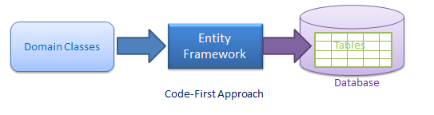
Code-First approach
CONFIDENTIAL | © 2019 EPAM Systems, Inc.

Slide 7
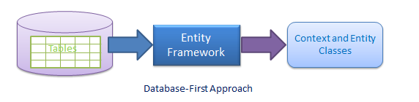
Database-First approach
CONFIDENTIAL | © 2019 EPAM Systems, Inc.

Slide 8
Code-First approach
Create classes
Define relationships (Conventions, Attributes, Fluent-API)
Create DBContext
CONFIDENTIAL | © 2019 EPAM Systems, Inc.

Slide 9
Code-First approach
public class MyContext: DbContext
{
protected override void OnConfiguring(DbContextOptionsBuilder optionsBuilder)
{ optionsBuilder.UseNpgsql(@"host=localhost;port=5432;database=db;username=root;password=12345");
}
public DbSet<Person> Persons { get; set; }
}
public class Person
{
public int Id { get; set; }
public string Name { get; set; }
public string Surname { get; set; }
}
using (MyContext context = new MyContext())
{
context.Persons.Add(new Person() {Name = "Oleg", Surname = "Tarusov"});
context.SaveChanges();
}

Slide 10
Configuring
Code Conventions
Data Annotation attributes
Fluent API
CONFIDENTIAL | © 2019 EPAM Systems, Inc.

Slide 11
Code Conventions
CONFIDENTIAL | © 2019 EPAM Systems, Inc.

Slide 12
Code Conventions
Schema | dbo, public
Primary Key | Id, <EntityClassId>
Foreign Key | as the principal entity primary key
Null | Nullable types: Classes, string
Not null | primitives: int, double, float
Cascade delete | yes
CONFIDENTIAL | © 2019 EPAM Systems, Inc.

Slide 13
Data Annotation
CONFIDENTIAL | © 2019 EPAM Systems, Inc.

Slide 14
Data Annotation Attributes
System.ComponentModel.DataAnnotations
System.ComponentModel.DataAnnotations.Schema
CONFIDENTIAL | © 2019 EPAM Systems, Inc.

Slide 15
System.ComponentModel.DataAnnotations
Attribute | Description
Key | Primary Key
Required | Not Null
MinLength | minimum string, byte length
MaxLength | maximum string, byte length
StringLength | maximum string, byte length
CONFIDENTIAL | © 2019 EPAM Systems, Inc.

Slide 16
System.ComponentModel.DataAnnotations.Schema
Attribute | Description
Table | Table name, schema name
Column | Column name
Index | Index for column
ForeignKey | Makes foreign key
NotMapped | force not to create column in db
CONFIDENTIAL | © 2019 EPAM Systems, Inc.

Slide 17
Data Annotation Attributes
[Table("People", Schema = "public")]
public class Person
{
public int Id { get; set; }
[Required]
[StringLength(50)]
public string Name { get; set; }
[Column("LastName")]
[Required]
[MinLength(3)]
[MaxLength(50)]
public string Surname { get; set; }
}
CONFIDENTIAL | © 2019 EPAM Systems, Inc.

Slide 18
Fluent API
CONFIDENTIAL | © 2019 EPAM Systems, Inc.

Slide 19
Fluent API
public class MyContext: DbContext
{
protected override void OnModelCreating(DbModelBuilder modelBuilder)
{
modelBuilder.HasDefaultSchema("public");
modelBuilder.Entity<Person>().Property(p => p.Name).IsRequired();
}
}
CONFIDENTIAL | © 2019 EPAM Systems, Inc.

Slide 20
Fluent API
modelBuilder().HasDefaultSchema(“public”) - schema
modelBuilder().Entity<Person>()
.HasKey(...) //Primary Key
.HasMany(...)//configures one to many or many to many
.HasOptional(...)//nullable foreign key
.Ignore(...)//don’t create a table in db
.ToTable(...)//table name
.HasTableAnnotation(...)//apply data annotation
CONFIDENTIAL | © 2019 EPAM Systems, Inc.

Slide 21
Fluent API
modelBuilder()
.Entity<Person>()
.Property(p => p.Name)
.HasColumnAnnotation(...)//set column annotation
.IsRequired()//not null
.HasColumnName(...)//column name
CONFIDENTIAL | © 2019 EPAM Systems, Inc.

Slide 22
Relationships
CONFIDENTIAL | © 2019 EPAM Systems, Inc.

Slide 23
Relationships
One to many
One to one/One to zero-or-one
Many to many
CONFIDENTIAL | © 2019 EPAM Systems, Inc.

Slide 24
One to many
Department
Person
CONFIDENTIAL | © 2019 EPAM Systems, Inc.

Slide 25
One to many: code conventions, first approach
public class Department
{
public int Id { get; set; }
[Index(IsUnique = true)]
public string Name { get; set; }
}
public class Person
{
public int Id { get; set; }
public string Name { get; set; }
public string Surname { get; set; }
public Department Department { get; set; }
}
CONFIDENTIAL | © 2019 EPAM Systems, Inc.

Slide 26
One to many: code conventions, second approach
public class Department
{
public int Id { get; set; }
[Index(IsUnique = true)]
public string Name { get; set; }
public ICollection<Person> Persons { get; set; }
}
public class Person
{
public int Id { get; set; }
public string Name { get; set; }
public string Surname { get; set; }
}
CONFIDENTIAL | © 2019 EPAM Systems, Inc.

Slide 27
One to many: code conventions, third approach
public class Department
{
public int Id { get; set; }
[Index(IsUnique = true)]
public string Name { get; set; }
public ICollection<Person> Persons { get; set; }
}
public class Person
{
public int Id { get; set; }
public string Name { get; set; }
public string Surname { get; set; }
public Department Department { get; set; }
}
CONFIDENTIAL | © 2019 EPAM Systems, Inc.

Slide 28
One to many: code conventions, fourth approach
public class Department
{
public int DepartmentId { get; set; }
[Index(IsUnique = true)]
public string Name { get; set; }
public ICollection<Person> Persons { get; set; }//optional
}
public class Person
{
public int Id { get; set; }
public string Name { get; set; }
public string Surname { get; set; }
public int DepartmentId { get; set; }
public Department Department { get; set; }
}
CONFIDENTIAL | © 2019 EPAM Systems, Inc.

Slide 29
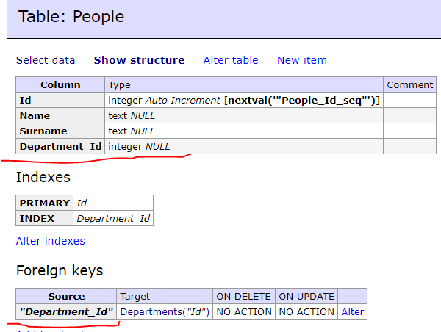
One to many: code conventions
CONFIDENTIAL | © 2019 EPAM Systems, Inc.

Slide 30
One to many: Data Annotation, first approach
public class Department
{
public int Id { get; set; }
public string Name { get; set; }
}
public class Person
{
public int Id { get; set; }
public string Name { get; set; }
public string Surname { get; set; }
[ForeignKey("Department")]
public int CurrentDepartmentId { get; set; }
public Department Department { get; set; }
}
CONFIDENTIAL | © 2019 EPAM Systems, Inc.

Slide 31
One to many: Data Annotation, second approach
public class Department
{
public int Id { get; set; }
public string Name { get; set; }
[ForeignKey("CurrentDepartmentId")]
public ICollection<Person> Persons { get; set; }
}
public class Person
{
public int Id { get; set; }
public string Name { get; set; }
public string Surname { get; set; }
public int CurrentDepartmentId { get; set; }
}
CONFIDENTIAL | © 2019 EPAM Systems, Inc.

Slide 32
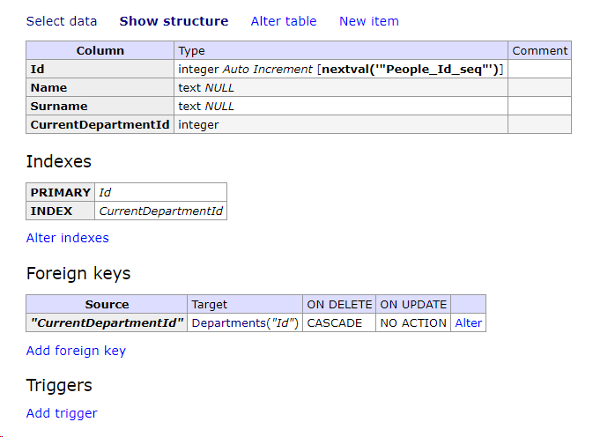
One to many: Data Annotation
CONFIDENTIAL | © 2019 EPAM Systems, Inc.

Slide 33
One to many: Fluent API
modelBuilder.Entity<Person>()
.HasOne<Department>(p => p.Department)
.WithMany(department => department.Persons)
.HasForeignKey<int>(p => p.CurrentDepartmentId);
CONFIDENTIAL | © 2019 EPAM Systems, Inc.

Slide 34
One to many: Fluent API
modelBuilder.Entity<Department>()
.HasMany(d => d.Persons)
.WithRequired(p => p.Department)
.HasForeignKey(p => p.CurrentDepartmentId);
CONFIDENTIAL | © 2019 EPAM Systems, Inc.

Slide 35
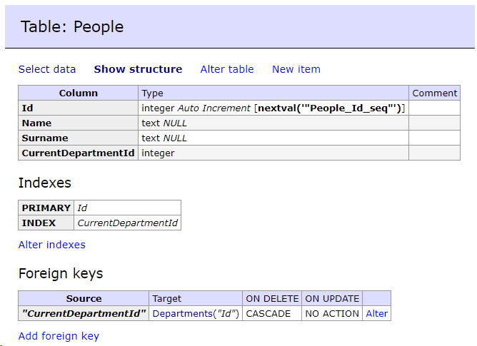
One to many: Fluent API
CONFIDENTIAL | © 2019 EPAM Systems, Inc.

Slide 36
One to one
Person
Address
CONFIDENTIAL | © 2019 EPAM Systems, Inc.

Slide 37
One to one: Code Conventions
public class Person
{
public int PersonId/Id { get; set; }
public string Name { get; set; }
public string Surname { get; set; }
public Address Address { get; set; }
}
public class Address
{
public int Id { get; set; }
public int PersonId { get; set; }
public string City { get; set; }
public string Street { get; set; }
public Person Person { get; set; }
}
CONFIDENTIAL | © 2019 EPAM Systems, Inc.

Slide 38
One to one: Data Annotation
public class Person
{
public int Id { get; set; }
public string Name { get; set; }
public string Surname { get; set; }
//public Address Address { get; set; }//optional
}
public class Address
{
[Key]
[ForeignKey("Person")]
public int PersonId { get; set; }
public string City { get; set; }
public string Street { get; set; }
public Person Person { get; set; }
}
CONFIDENTIAL | © 2019 EPAM Systems, Inc.

Slide 39
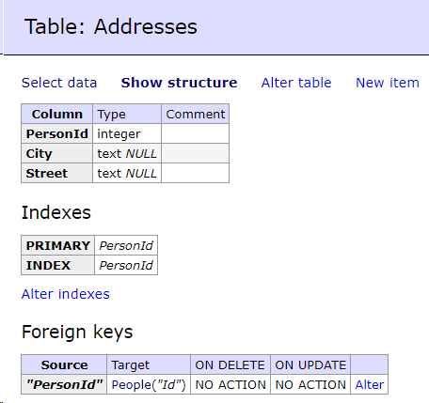
One to one: Data Annotation
CONFIDENTIAL | © 2019 EPAM Systems, Inc.

Slide 40
One to one: Fluent API
public class Person
{
public int Id { get; set; }
public string Name { get; set; }
public string Surname { get; set; }
public Address Address { get; set; }
}
public class Address
{
public int PersonId { get; set; }
public string City { get; set; }
public string Street { get; set; }
public Person Person { get; set; }
}
CONFIDENTIAL | © 2019 EPAM Systems, Inc.

Slide 41
One to one: Fluent API
modelBuilder.Entity<Person>().HasOne(p => p.Address).WithOne(a => a.Person)
CONFIDENTIAL | © 2019 EPAM Systems, Inc.

Slide 42
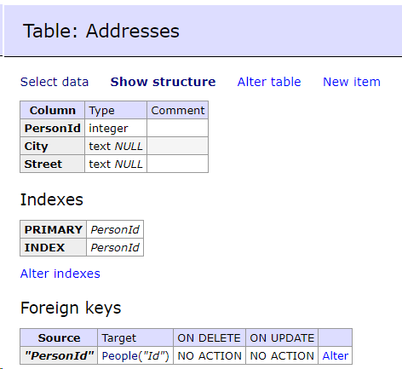
One to one: Fluent API
CONFIDENTIAL | © 2019 EPAM Systems, Inc.

Slide 43
Many to Many
Person
Department
CONFIDENTIAL | © 2019 EPAM Systems, Inc.

Slide 44
Many to many: Code conventions
public class Person
{
public int Id { get; set; }
public string Name { get; set; }
public string Surname { get; set; }
public ICollection<Department> Departments {get; set;}
}
public class Department
{
public int Id { get; set; }
public string Name { get; set; }
public ICollection<Person> Persons { get; set; }
}
CONFIDENTIAL | © 2019 EPAM Systems, Inc.

Slide 45
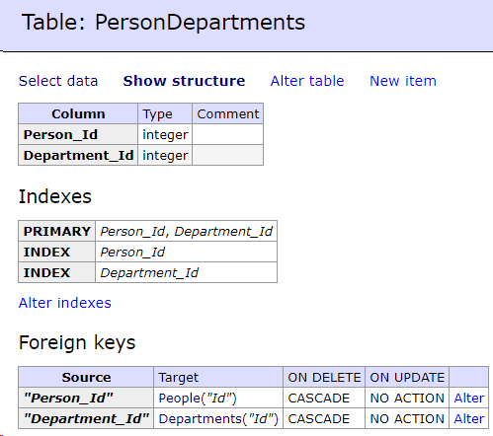
Many to many: Code conventions
CONFIDENTIAL | © 2019 EPAM Systems, Inc.

Slide 46
Many to many: Fluent API
public class Person
{
public int Id { get; set; }
public string Name { get; set; }
public string Surname { get; set; }
public ICollection<Department> Departments {get; set;}
}
public class Department
{
public int Id { get; set; }
public string Name { get; set; }
public ICollection<Person> Persons { get; set; }
}
CONFIDENTIAL | © 2019 EPAM Systems, Inc.

Slide 47
Many to many: Fluent API
modelBuilder.Entity<Person>().HasMany(p => p.Departments).WithMany(d => d.Persons)
.UsingEntity(j => j.ToTable("PersonToDepartment"));
CONFIDENTIAL | © 2019 EPAM Systems, Inc.

Slide 48
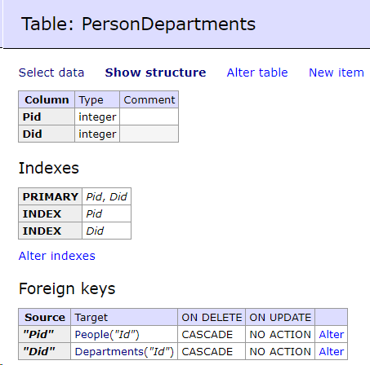
Many to many: Fluent API
CONFIDENTIAL | © 2019 EPAM Systems, Inc.

Slide 49
Queries
CONFIDENTIAL | © 2019 EPAM Systems, Inc.

Slide 50
Queries
LINQ-to-Entities, LINQ Method
LINQ-to-Entities, LINQ Query syntax
CONFIDENTIAL | © 2019 EPAM Systems, Inc.

Slide 51
LINQ-to-Entities, LINQ Method
var data0 = context.Persons.Include(p => p.Department)
OR
var data0 = context.Persons.Include("Department")
OR
var data0 = context.Persons.Include(nameof(person.Department))
CONFIDENTIAL | © 2019 EPAM Systems, Inc.

Slide 52
LINQ-to-Entities, LINQ Method
var data = context.Persons.Join(context.Departments,
p => p.Department.Id,
d => d.Id,
(p1, d1) => new {Name = p1.Name, DepartmentName = d1.Name});
OR
var data2 = context.Departments.Join(context.Persons, d => d.Id, p => p.Department.Id,
(d, p) => new { DepartmentName = d.Name, Name = p.Name });
CONFIDENTIAL | © 2019 EPAM Systems, Inc.

Slide 53
LINQ-to-Entities, LINQ Method
var data3 = context
.Persons
.GroupBy(p => p.Department.Id)
.Select(persons => new {key = persons.Key, count = persons.Count()});
CONFIDENTIAL | © 2019 EPAM Systems, Inc.

Slide 54
LINQ-to-Entities, LINQ Query Syntax
var data4 = from p in context.Persons
join d in context.Departments on p.Department.Id equals d.Id
select new {Name = p.Name, DepartmentName = d.Name};
var data5 = from p in context.Persons
group p by p.Department.Id into entry
select new {key = entry.Key, count = entry.Count()};
CONFIDENTIAL | © 2019 EPAM Systems, Inc.

Slide 55
Migrations
CONFIDENTIAL | © 2019 EPAM Systems, Inc.

Slide 56
Migrations
To enable migrations you need run
Install-Package Microsoft.EntityFrameworkCore.Tools
CONFIDENTIAL | © 2019 EPAM Systems, Inc.

Slide 57
Migrations
Add-Migration <Name>
Remove-Migration
Update-Database
CONFIDENTIAL | © 2019 EPAM Systems, Inc.

Slide 58
Rollback
Update-database
Update-Database <Name>
Update-Database 0
CONFIDENTIAL | © 2019 EPAM Systems, Inc.

Slide 59
Package Manager Console <-> Command Line
Package Manager Console | Command Line
add-migration addAddress | dotnet ef migrations add Address
update-database | dotnet ef database update
update-database Init | dotnet ef database update init
CONFIDENTIAL | © 2019 EPAM Systems, Inc.

Slide 60
Seeding
CONFIDENTIAL | © 2019 EPAM Systems, Inc.

Slide 61
Seeding
Model Seed Data
Manual Migration Customization
Custom Initialization Logic
CONFIDENTIAL | © 2019 EPAM Systems, Inc.

Slide 62
Model Seed Data
protected override void OnModelCreating(ModelBuilder modelBuilder)
{
modelBuilder.Entity<Person>().HasData(new {
Id = 1,
Name = "Oleg", Surname = "Tarusov"
});
modelBuilder.Entity<Person>().HasData(new
Person {
Id = 2,
Name = "Vasya",
Surname = "Petrov"
});
}
CONFIDENTIAL | © 2019 EPAM Systems, Inc.

Slide 63
Model Seed Data
Requires primary key value even it’s generated by the database
if primary key value is changed, previously seeded data will be removed (in migrations)
CONFIDENTIAL | © 2019 EPAM Systems, Inc.

Slide 64
Manual Migration Customization
public partial class Data : Migration
{
protected override void Up(MigrationBuilder migrationBuilder)
{
migrationBuilder.InsertData(table: "Persons", columns: new[] { "Name", "Surname" }, values: new object[] { "Oleg", "Tarusov" });
}
protected override void Down(MigrationBuilder migrationBuilder)
{
migrationBuilder.DeleteData(table: "Persons", keyColumn: "Name", "Oleg");
}
}
CONFIDENTIAL | © 2019 EPAM Systems, Inc.

Slide 65
Custom Initialization Logic
using (var context = new MyContext())
{
//context.Database.EnsureDeleted();
//context.Database.EnsureCreated();
context.Persons.Add(new Person()
{
Name = "Oleg",
Surname = "Tarusov"
});
context.SaveChanges();
}
CONFIDENTIAL | © 2019 EPAM Systems, Inc.

Slide 66
Custom Initialization Logic
Be careful with concurrency
CONFIDENTIAL | © 2019 EPAM Systems, Inc.

Slide 67
Database first
CONFIDENTIAL | © 2019 EPAM Systems, Inc.

Slide 68
Database-first: Core
nuget package Microsoft.EntityFrameworkCore.Tools
PMC: Scaffold-DbContext "Server=localhost; DataBase=db;Integrated Security=false; User Id=root;password=12345" Npgsql.EntityFrameworkCore.PostgreSQL
CLI: dotnet ef dbcontext Scaffold-DbContext "Server=localhost; DataBase=db;Integrated Security=false; User Id=root;password=12345" Npgsql.EntityFrameworkCore.PostgreSQL
CONFIDENTIAL | © 2019 EPAM Systems, Inc.

